Slide 1
Part 1: Introduction to Java
Mattias Svensson Nordell

Slide 2

What is Java?

Slide 3
The Java segments
Java Standard Edition (Java SE)
Java Enterprise (Java EE)
Java Micro Edition (Java ME)
Obtain Latest Java Development kit from (JDK): https://www.oracle.com/downloads/index.html

Slide 4


Java Key Features
Applets
Security
Portability

Slide 5
Java Bytecode
Java is a interpreted language
Optimized instructions designed to run on a virtual machine

Slide 6
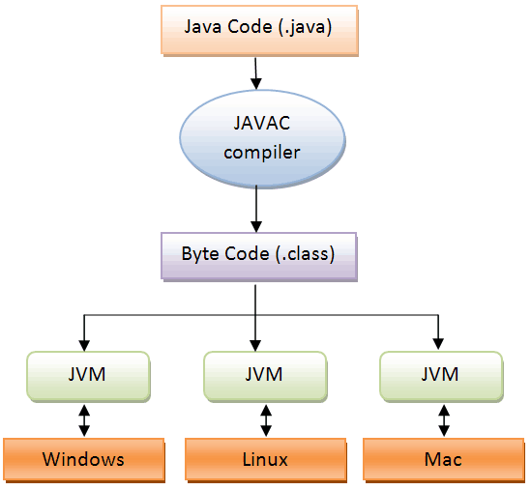
The Java Virtual Machine (JVM)

Slide 7
Compiling and running java programs
Commands in dos
Compile: javac MyClass.java
Run: java MyClass

Slide 8
Object Orientation
Reusable Code
Classes and Objects
Organization
Inheritance and Composition

Slide 9

Encapsulation
Black box model
Access modifiers

Slide 10
Exercise 1: Obtaining the JDK
1. Check your Current configuration (java –version , javac -version)
2. Download latest JDK from Oracle
3. Install JDK
4. Set Path (Environmental Variables)
5. Test environment (Compile and run from dos)

Slide 11
Comments
//This is a one-line comment
/*This is a multiple-line
comment*/
Javadoc comments (html compatible)
/**
*description: This is a Javadoc comment
*block tags/annotations
*/
class, field, interface, constructor or method

Slide 12
A first Simple Program
1. Enter the code
2. Compile
3. Run
4. Handle Syntax Errors

Slide 13
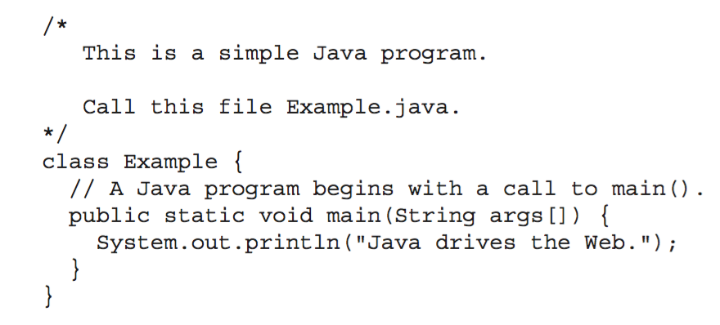
The source code

Slide 14
main method explained
Entry point for your program
Takes a set of parameters
Makes your program runnable
public static void main(Strings[] args);

Slide 15

Introducing Netbeans
Compile and Run
Code Completion/InteliSense
Handle Syntax Errors
Built in quick functions
And much much more
Avoid coding in a texteditor!

Slide 16
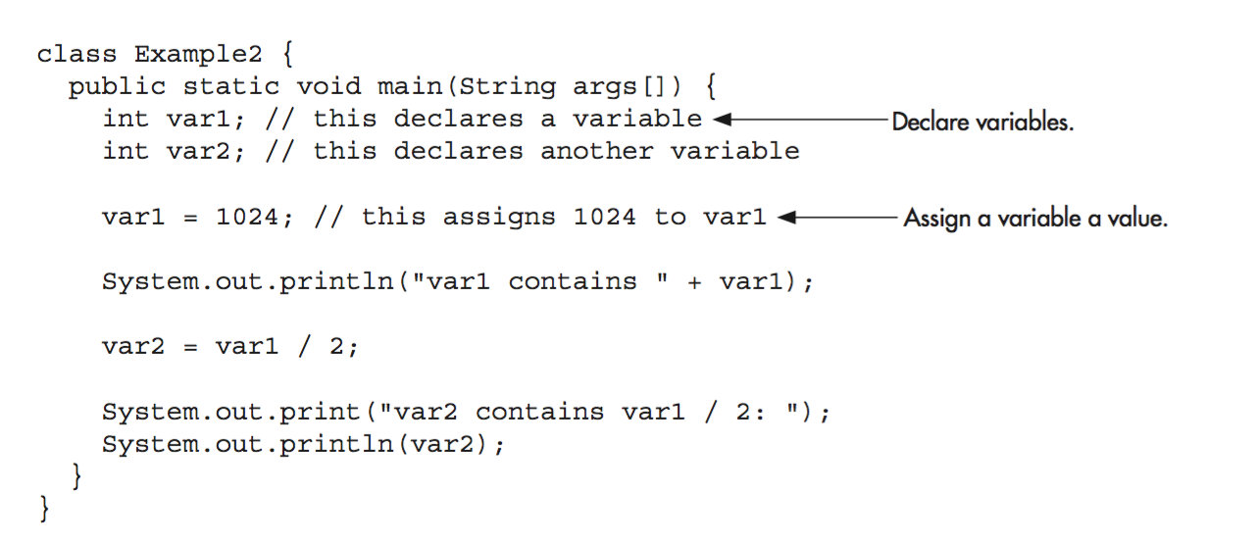
Try the following code in Netbeans Can you understand how it works?

Slide 17
Operators
+
-
*
/

Slide 18
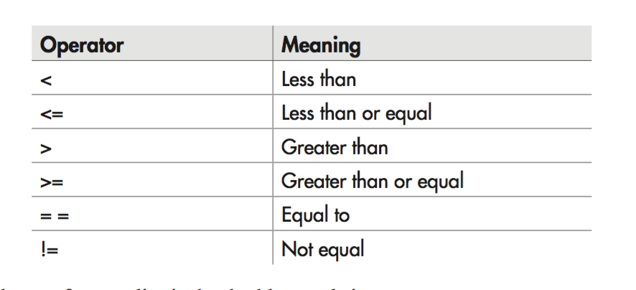
More operators

Slide 19
Variables
accessmodifier-type-varname = value;
byte, short, int, long, float, double, char, String, Boolean
Check sizes online and memorize
Everything in Java needs and Explicit type declared!
Be careful when casting!

Slide 20
Naming Variables
Variables may start with any letter, underscore or dollarsign
Which of the following variables and valid?
€myHouse
myHouse
$myHouse
_myHouse
007-myHouse

Slide 21
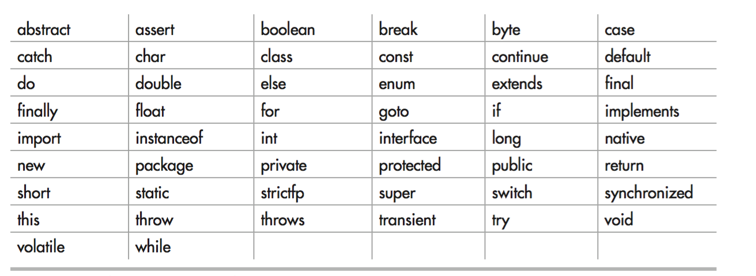
Java Reserved Keywords (Not Full List)

Slide 22
Two Control Statements
If/else
for
Other loops (later in the course)

Slide 23
Code blocks {}
Can be created anywhere in your program
A set of code lines that are executed together
Static blocks, methods blocks, regular blocks

Slide 24
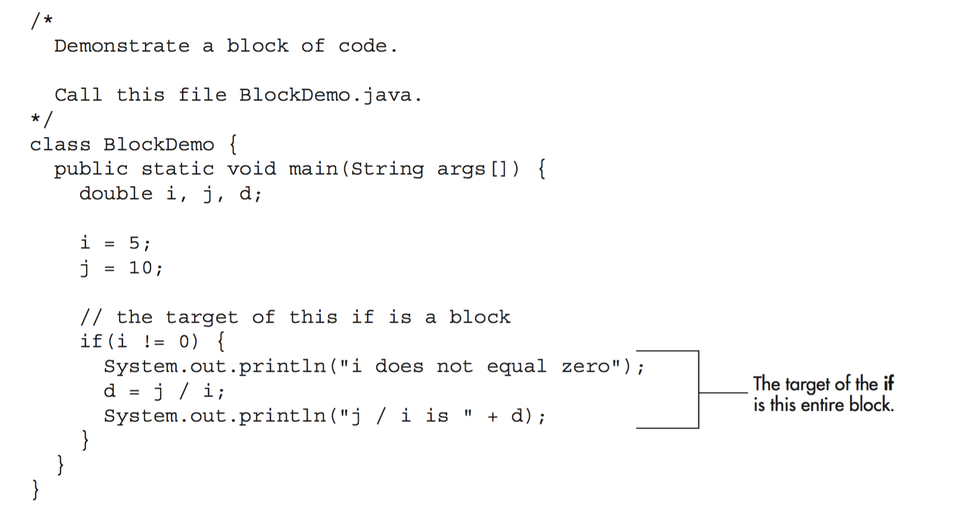
The If statement with code block

Slide 25
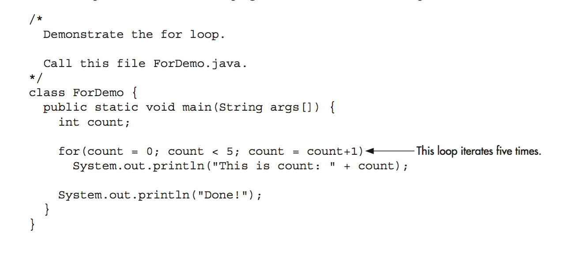
Demonstration of for Loop

Slide 26
Semicolons, Positioning and Indenting
Semicolon after each code statements is required
Positioning and indenting makes code more readable and is strongly recommended but not required

Slide 27
Naming conventions, use them!!
Naming Conventions: http://www.oracle.com/technetwork/java/codeconventions-135099.html

Slide 28
A few things to remember
Java is Case sensitive
Everything in Java needs a type
Writing clean/beautiful code makes you a good programmer. Try to organize yourself.
Use the naming conventions

Slide 29
A Few Basic Concepts If there is extra time
Mattias Svensson Nordell

Slide 30
Objects
Real life objects
State are stored as instance Variables
Methods manipulate instance Variables and defines behavior

Slide 31

A radio is a object
States are: Volume, frequency, On/Off….and more
Behavior: Turn On, Turn off, Change frequency, Chance Volume and more.

Slide 32
Construct many objects = lots of code?
Different Radios, same functionality

Slide 33

Classes – A blueprint for objects

Slide 34
Whats in a Class?
Instance Variables to store states
Methods to define behavior
Constructor to initialize state variables

Slide 35
Encapsulating Data
Hiding data from the user
Public methods are used to access instance variables
Getters and Setters

Slide 36
Discussion Questions
Real-world objects contain state and behavior.
A software object's state is stored in instance variables.
A software object's behavior is exposed through methods.
Hiding internal data from the outside world, and accessing it only through publicly exposed methods is known as data encapsulation.
A blueprint for a software object is called a class.

Slide 37
Lecture 1 Variables, Classes, Methods, Objects and Control Statements
Mattias Svensson Nordell

Slide 38
Data types
All operations in java are checked for type compatibility
There are no type-less variables
Illegal types will not compile!

Slide 39
Java´s Primitive Types

Slide 40
Integers

Slide 41
Floating-Point types
To handle decimal numbers
float 32bit
double 64bit

Slide 42
Unicode Characters
Unicode defines the symbols used in all human languages
ASCI code is a subset of Unicode
Charactes are enclosed by single quotes , for example ‘a’

Slide 43
Boolean
true or false
Often used for comparsions

Slide 44
literals
Are reduced to a value (often called constants)

Slide 45
Special characters

Slide 46
String Literals
Enclosed by “” , for example “this is a string literal”

Slide 47
Initalizing Variables
type-name = value
default initializers
No value assigned
explicitly.

Slide 48
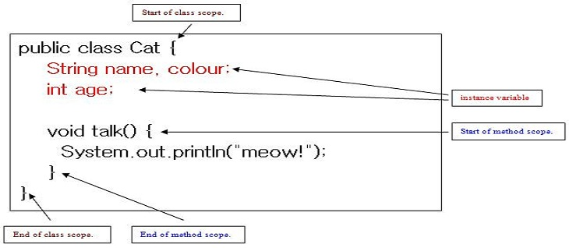
Variables scoping

Slide 49
What does a class contain?
Class Name
Constructor
Instance Variables
Methods

Slide 50
Constructor
Used to Initalize Instance Variables
Method with same name as class

Slide 51
Instance Variables
Contain specific information about a object
Think of a programming object as blueprint for creating an object

Slide 52
Methods
Parameters
Return types
Access modifiers

